Slide 1


Exploratory Data Analysis Project
Breast Cancer Survival analysis
- Ravi Dhir

Slide 2

Objective
To Analyse the Breast Cancer Patients
Survival Data from a study that was
conducted between 1958 and 1970
at the University of Chicago's Billings Hospital.

Slide 3
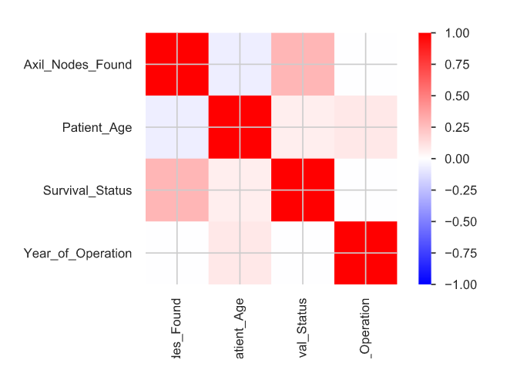
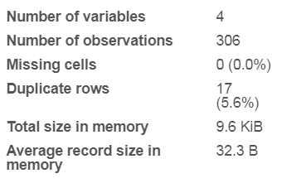
About the Data Set
At a Glance:
Correlation between Data

Slide 4
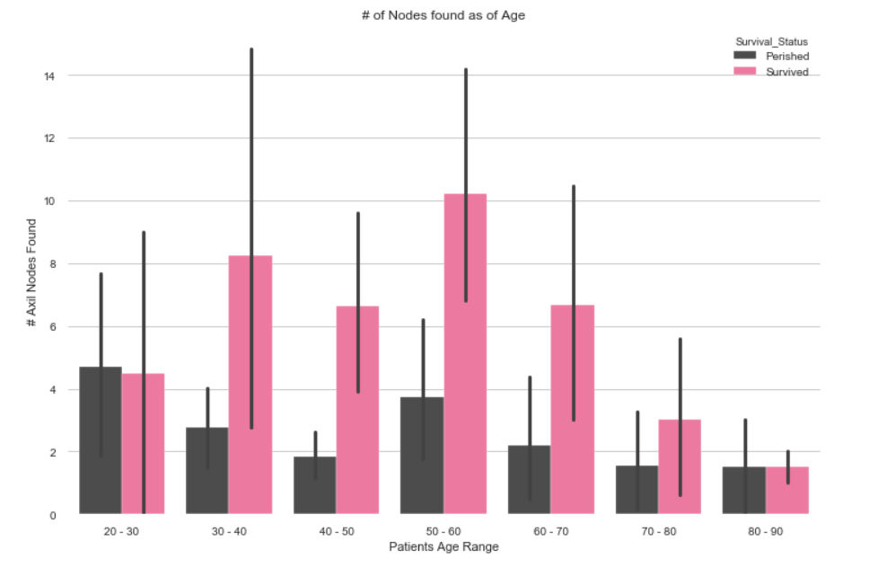
Patients Age vs Axil Nodes (Bar)
We can see that maximum nodes found are for mid aged patients, however for Senior Citizen Patients the number of nodes are very few.

Slide 5
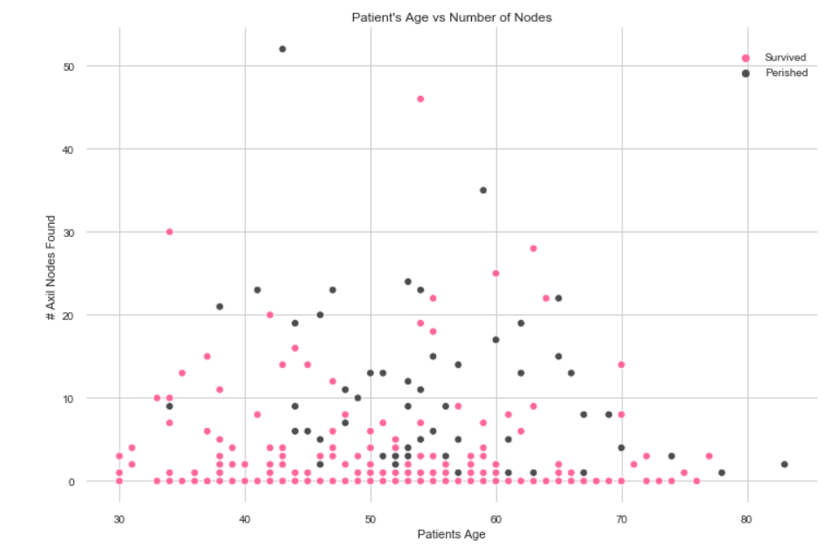
Patients Age vs Axil Nodes (Scatter)
From the scatter plot it is evident the lesser the number of nodes, better are chances of survival.

Slide 6
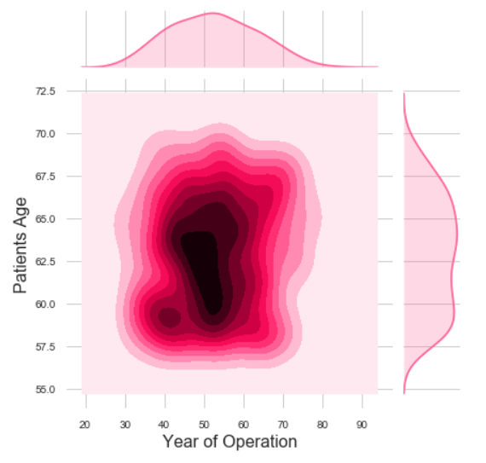
Age vs Year of Operation (Joint Plot)
The Plot shows that more number of patients undergone operation during the year 1960 - 1964 period and between ages 45 - 55

Slide 7
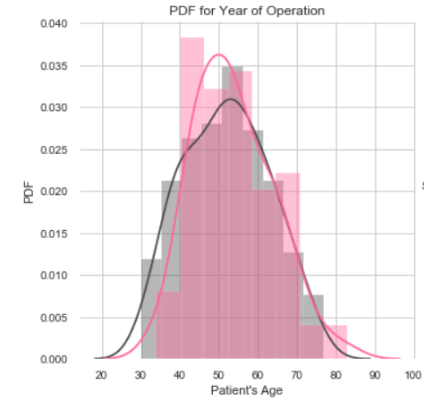
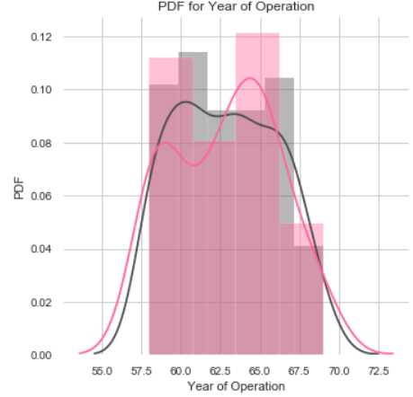
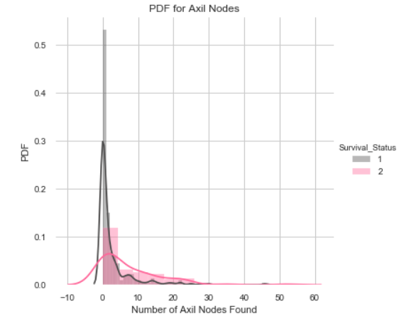
Probability Density Functions
The various PDF Show, that for age Group 40-50, in Year 1064-1066 the success rate was most patients with least number of nodes.

Slide 8
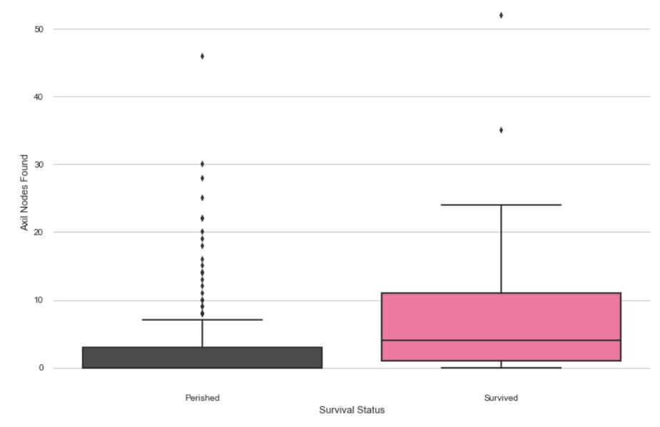
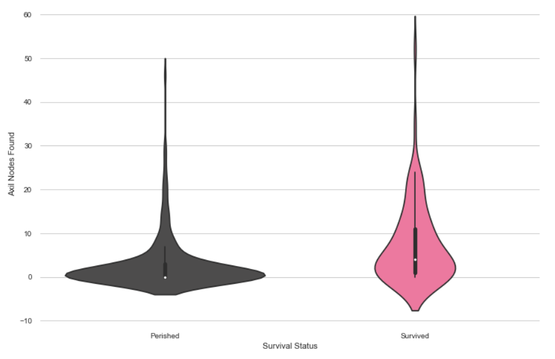
Box and Violin Plots
1 . About 50 percentile people have Axillary nodes 0 and 75 percentile have about 3~ axillary nodes.
2 . bout 50 percentile people have Axillary nodes more than 4~ and 25 percentile patients have 1-3 nodes.

Slide 9
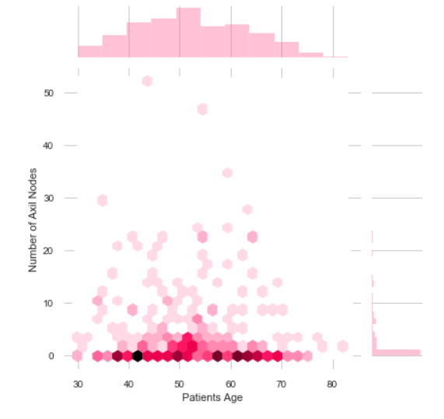
Conclusion
From the above graphs, we can clearly conclude the below points:
As Number of Nodes Increase, the chances of Survival are less.
Lesser age group has a better Survival Rate.
Number of Nodes detected are less is a patient is senior Citizen.

